Slide 1

Health Tracker and recommmender system
A gui (graphical user interface) project.

Slide 2
Objective
The primary objective of this project is to implement what we’ve learnt throughout our course of Python programming and use that to develop a Graphical User Interface (GUI) for Health tracker and & recommender system with almost all required functionalities. This project also aims at providing a simple and clean interface to the users which reduces the wastage of time.

Slide 3

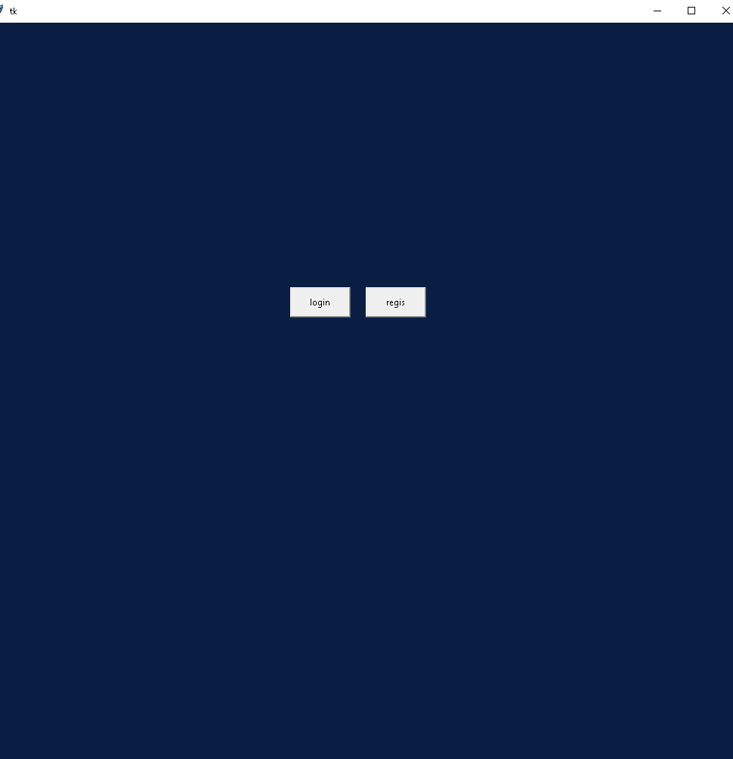
The first window

Slide 4
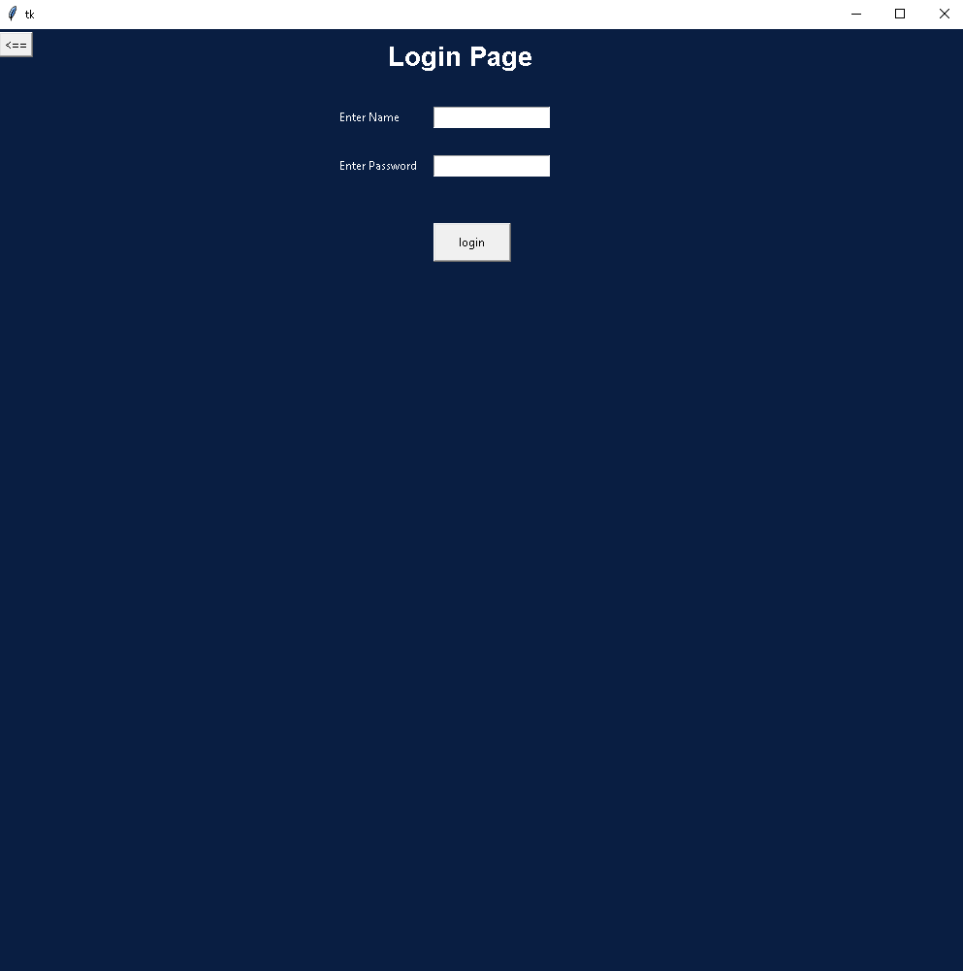
The second window
If you chose to login then this window appears.

Slide 5
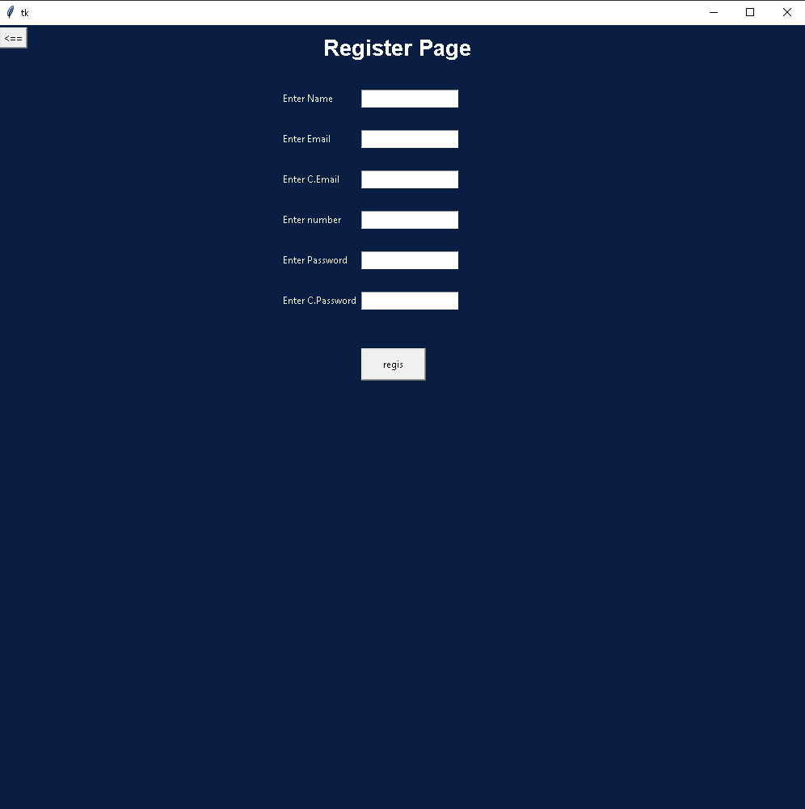
The Third window
If you choose to register then you get this window.

Slide 6

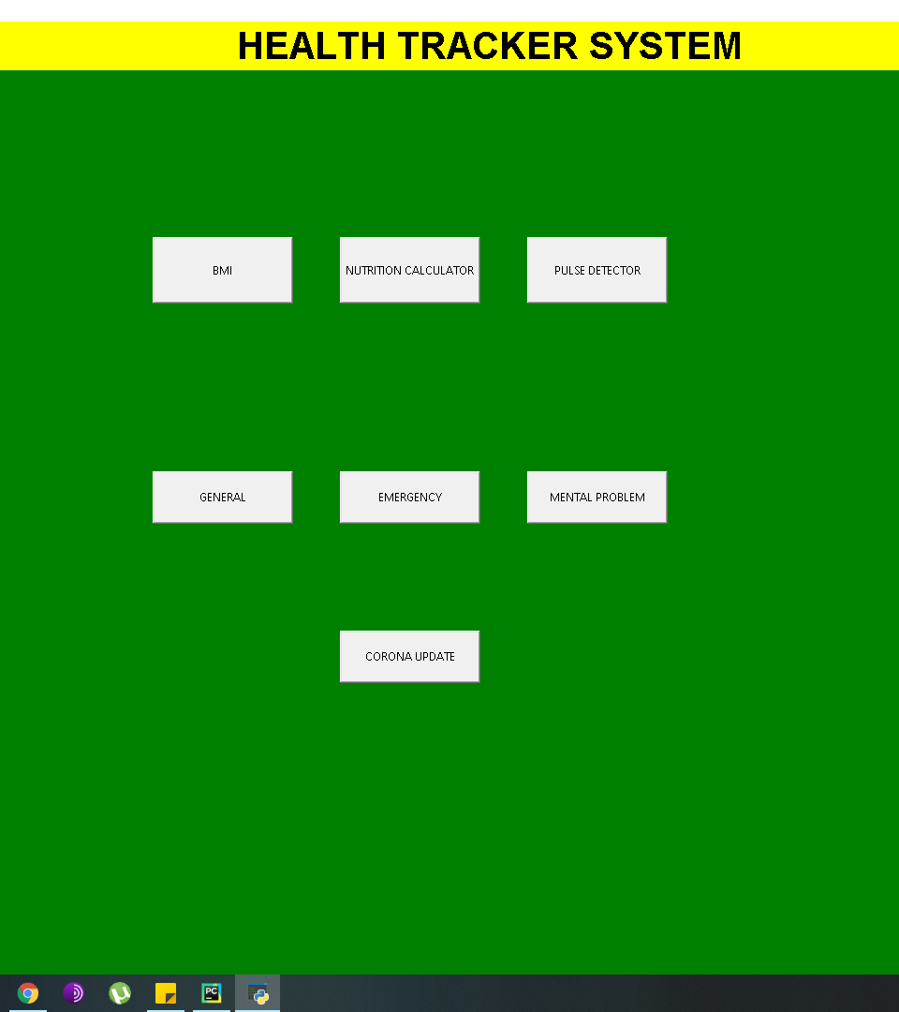
The fourth window
After you press register you will be directed to this window.

Slide 7
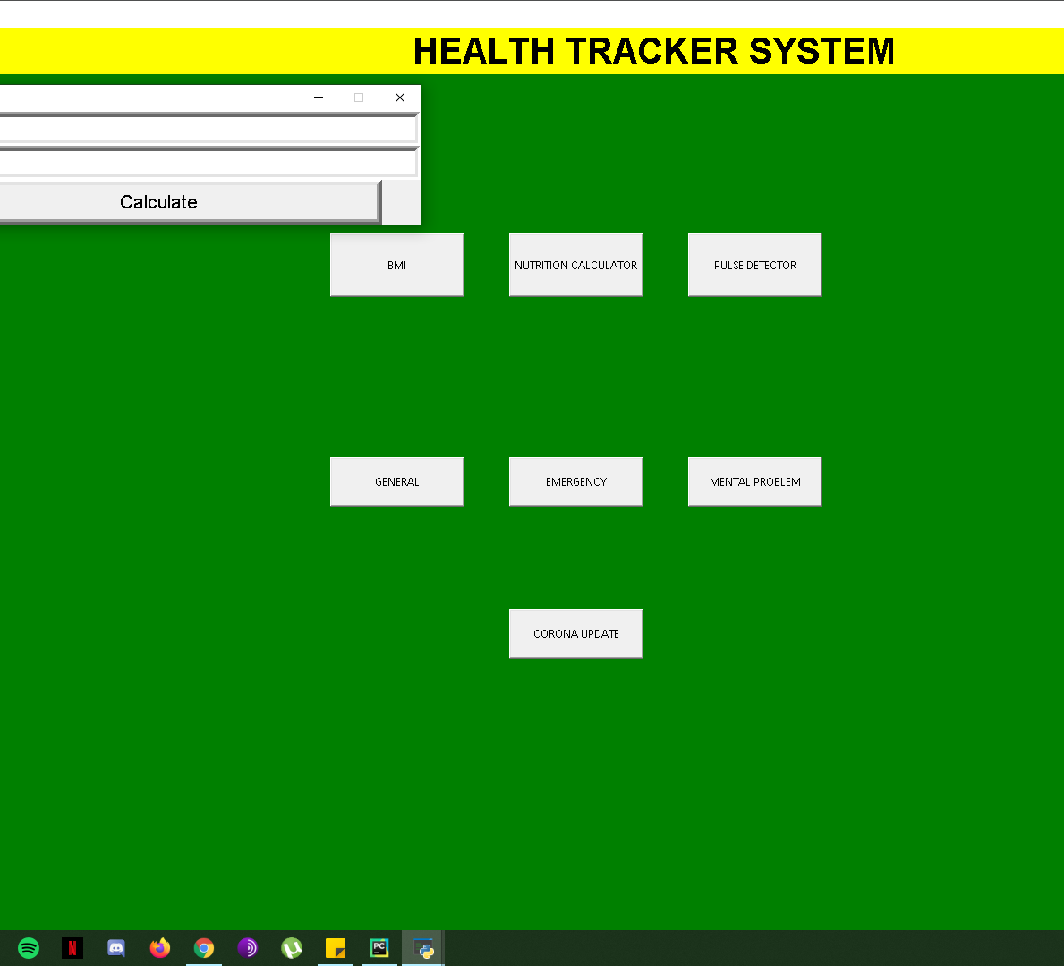
The fifth window
When you press the BMI button this calculator window opens.

Slide 8
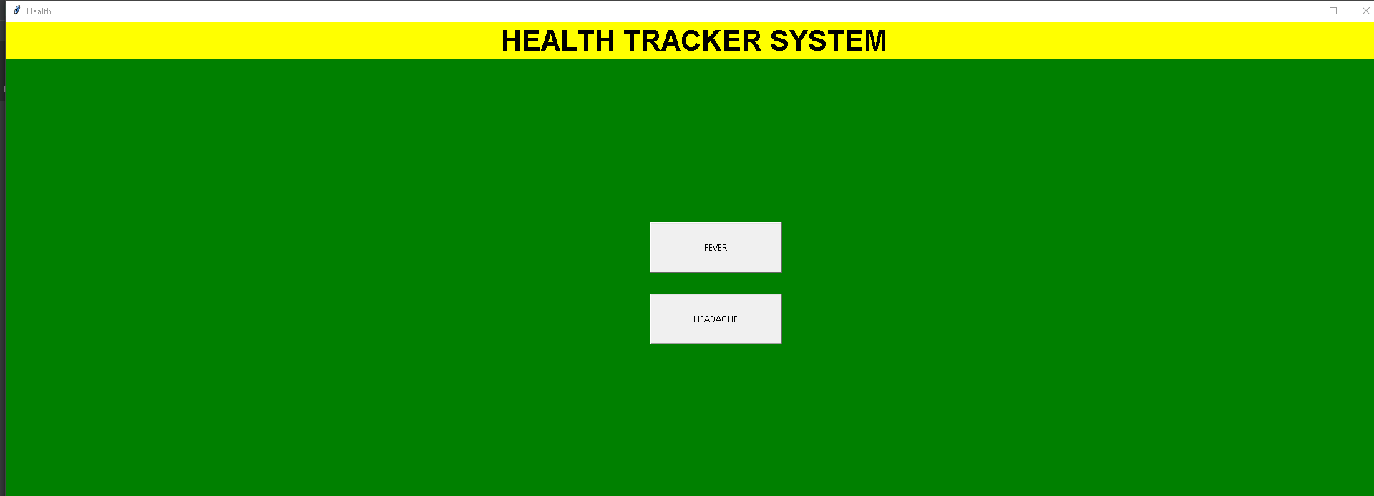
The sixth window
If you choose the general BUTTON here, you will be lead to this window.

Slide 9
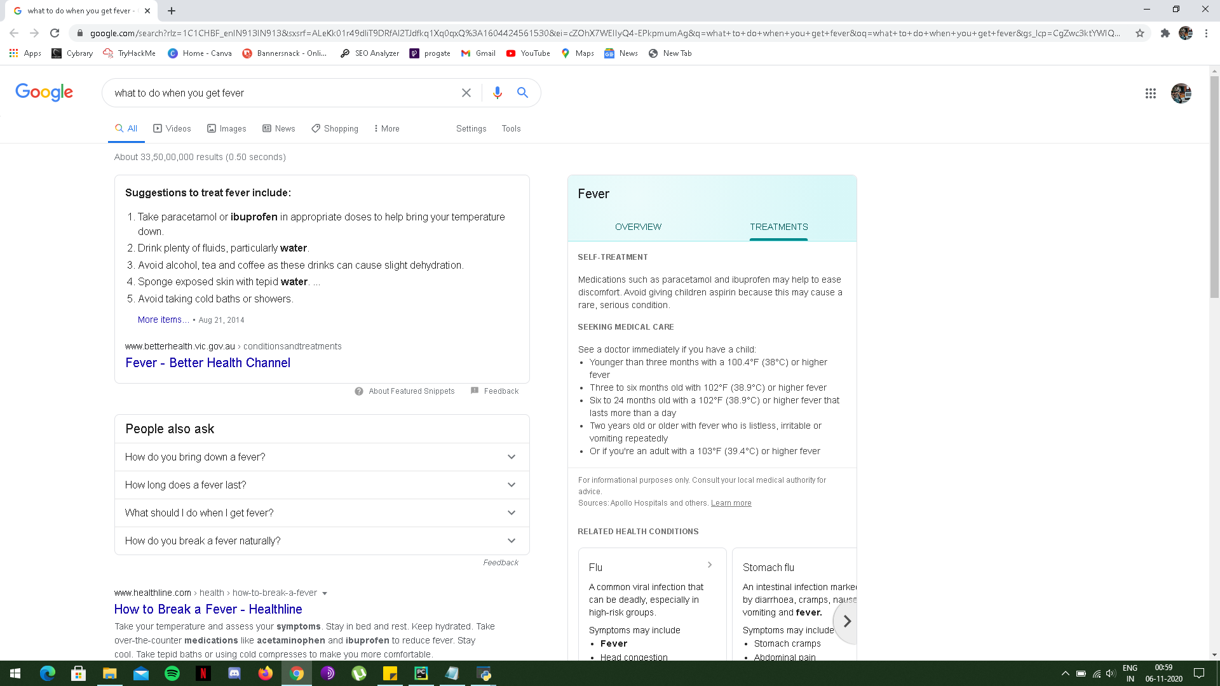
The seventh window
Now if you choose the fever option then this will lead you to this google search window.

Slide 10
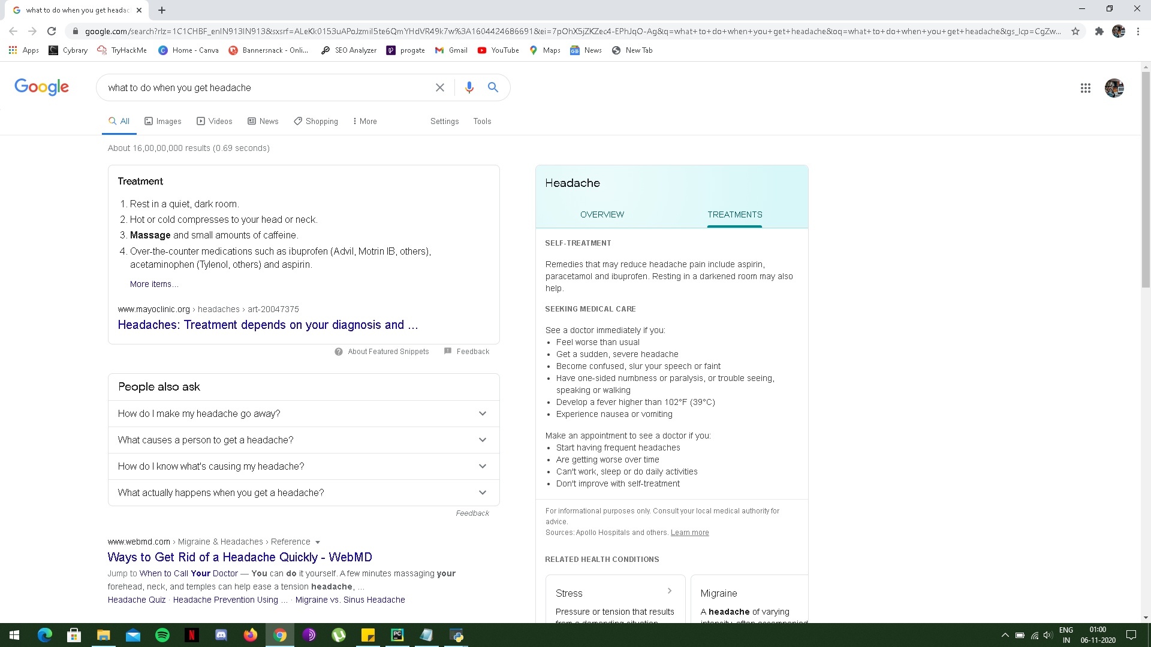
The eighth window
NOW IF YOU CHOOSE THE headache OPTION THEN THIS WILL LEAD YOU TO THIS GOOGLE SEARCH WINDOW.

Slide 11
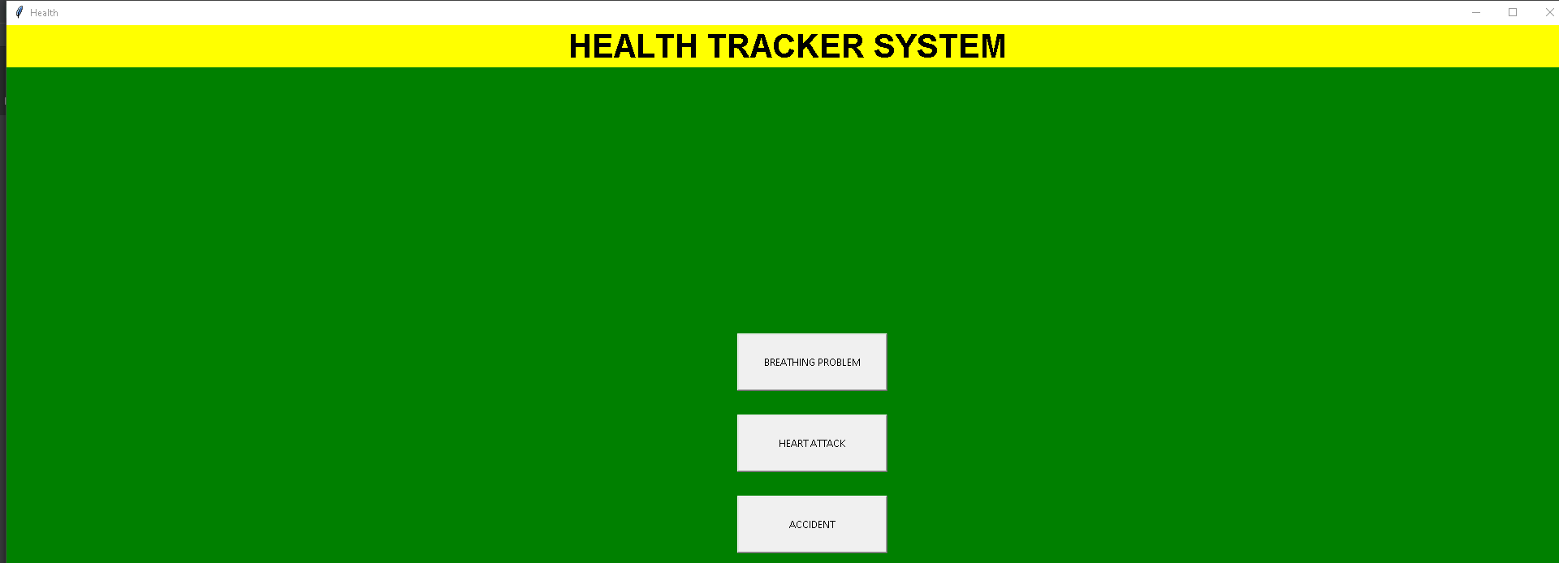
The ninth window
Now if you choose emergency button then you will be lead to this window.

Slide 12
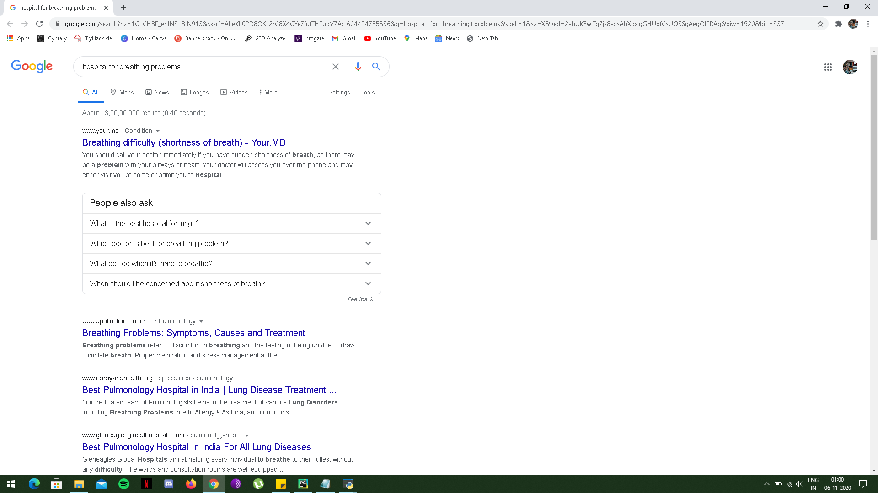
The tenth window
NOW IF YOU CHOOSE THE breathing problem OPTION THEN THIS WILL LEAD YOU TO THIS GOOGLE SEARCH WINDOW.

Slide 13
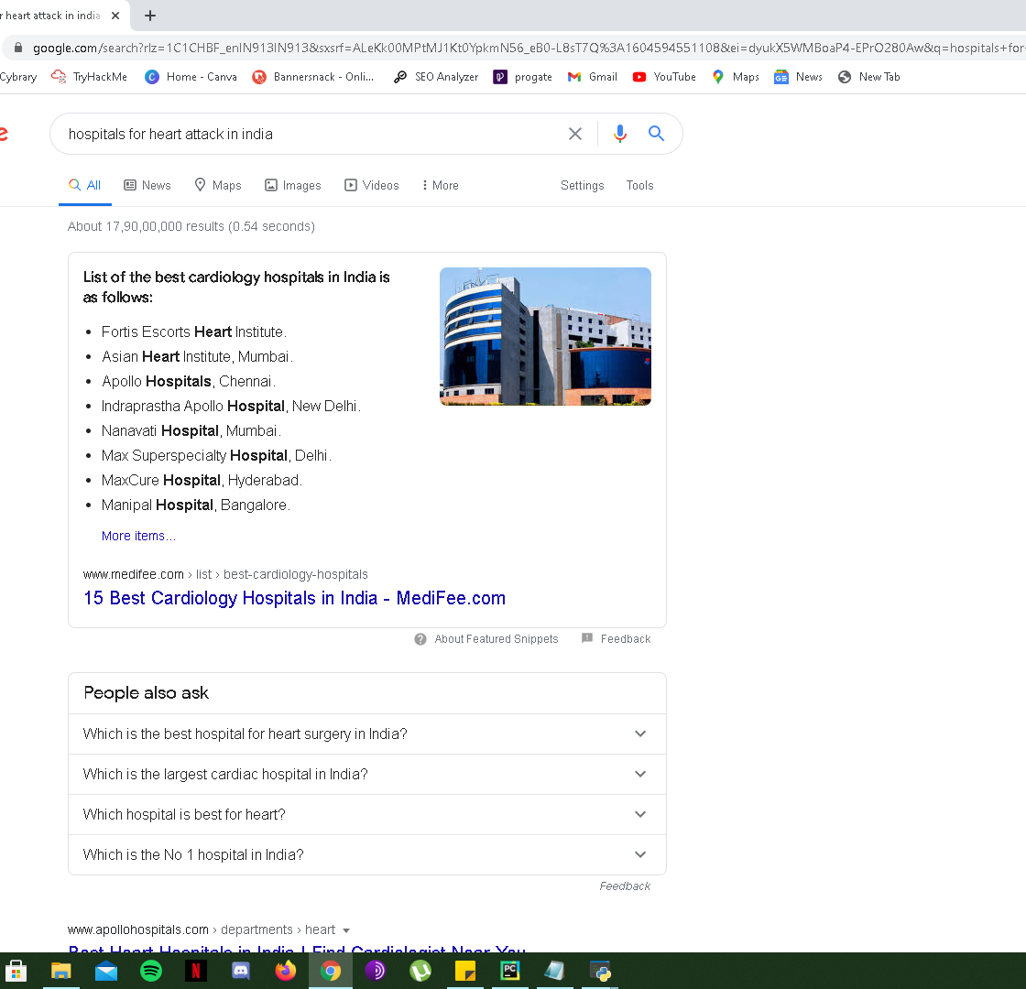
The eleventh window
NOW IF YOU CHOOSE THE HEART ATTACK OPTION THEN THIS WILL LEAD YOU TO THIS GOOGLE SEARCH WINDOW.

Slide 14
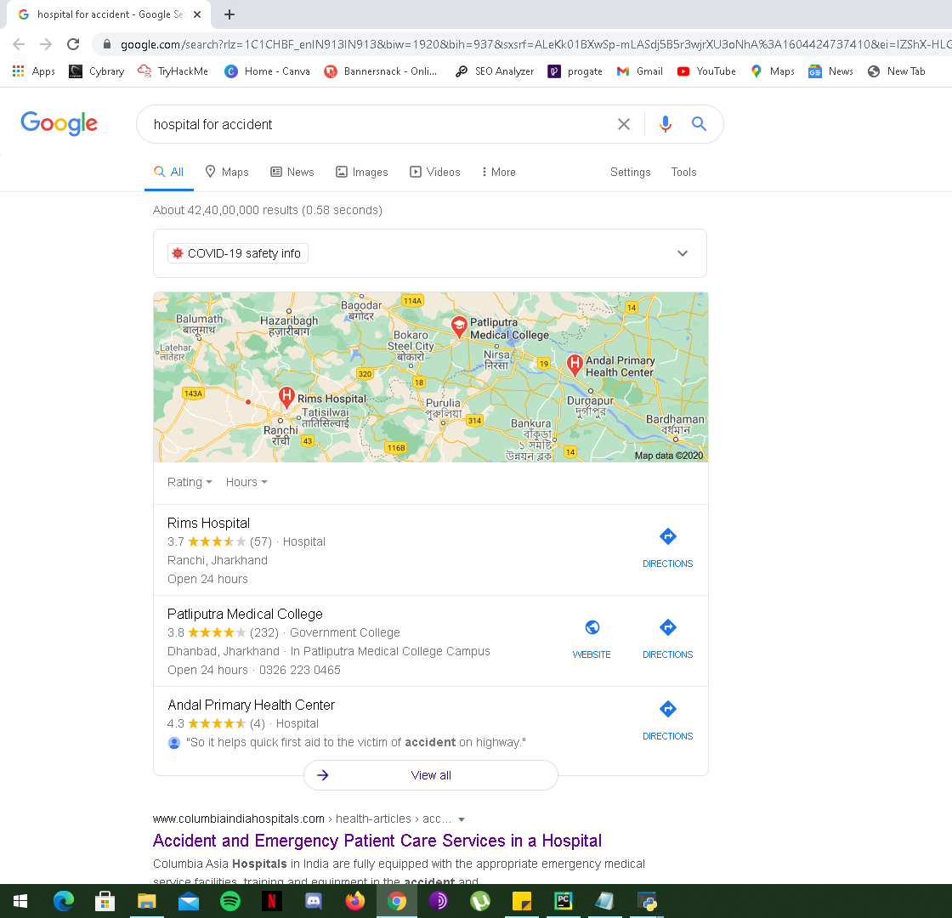
THE TWELVTH WINDOW
NOW IF YOU CHOOSE THE ACCIDENT OPTION THEN THIS WILL LEAD YOU TO THIS GOOGLE SEARCH WINDOW.

Slide 15
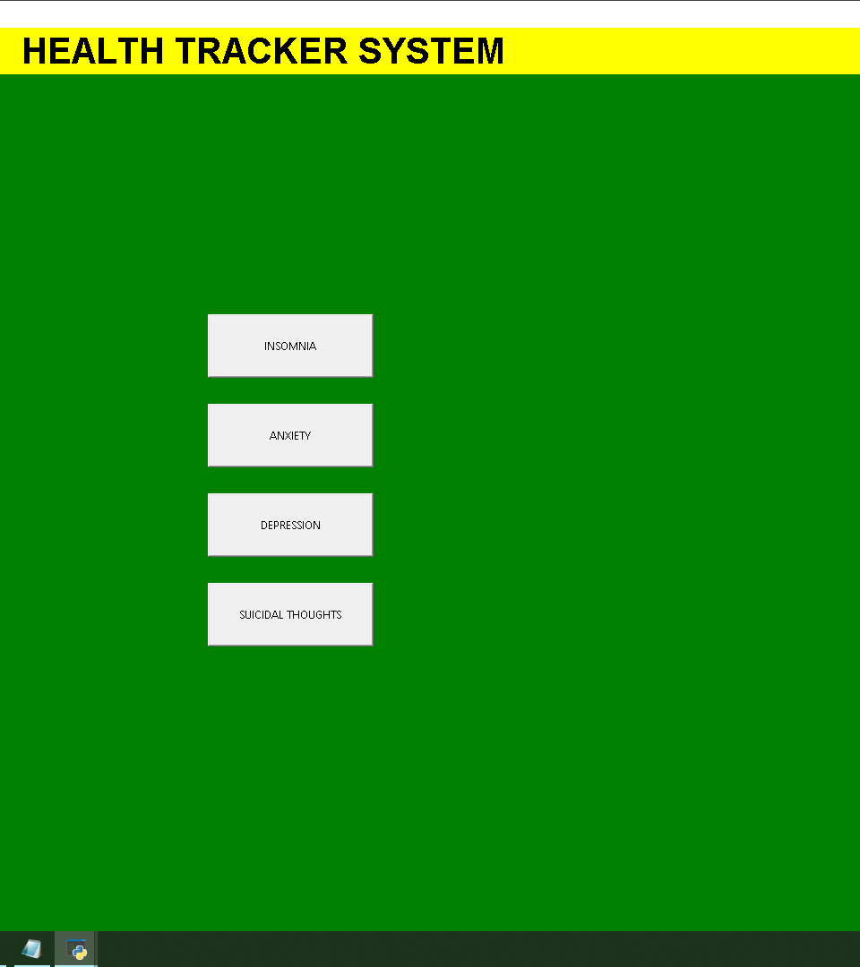
THE THIRTEENTH WINDOW
Now if you choose MENTAL PROBLEM button then you will be lead to this window.

Slide 16
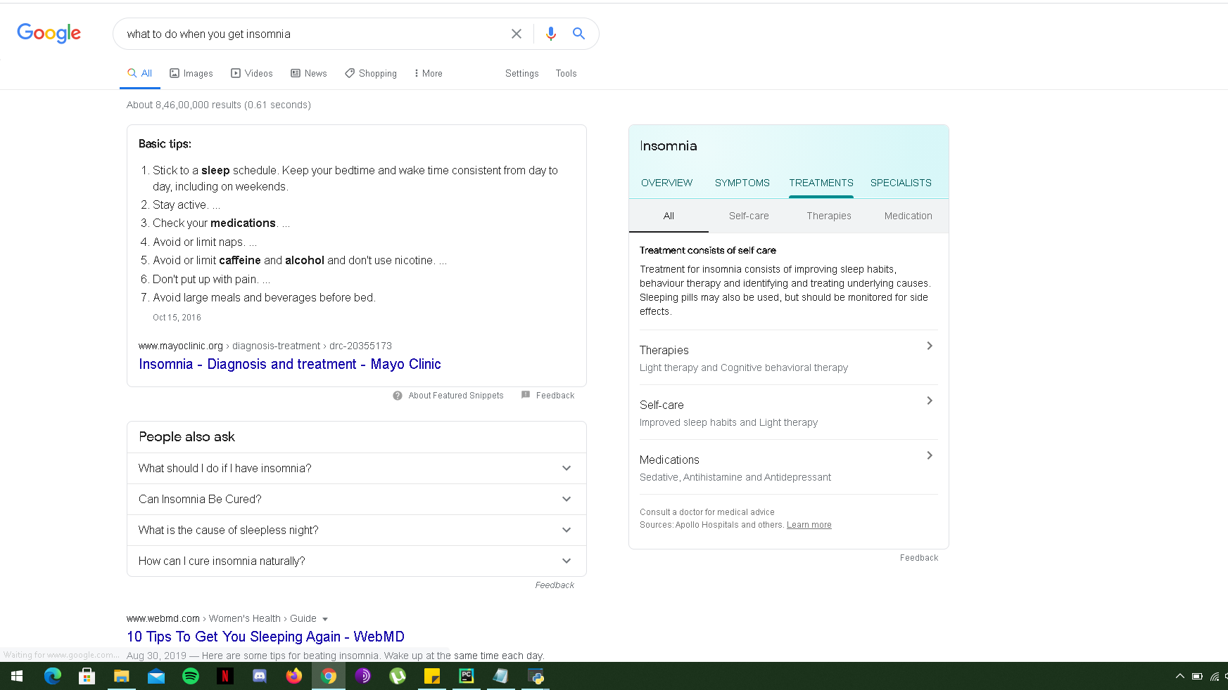
THE FOURTEENTH WINDOW
NOW IF YOU CHOOSE THE INSOMAINA OPTION THEN THIS WILL LEAD YOU TO THIS GOOGLE SEARCH WINDOW.

Slide 17
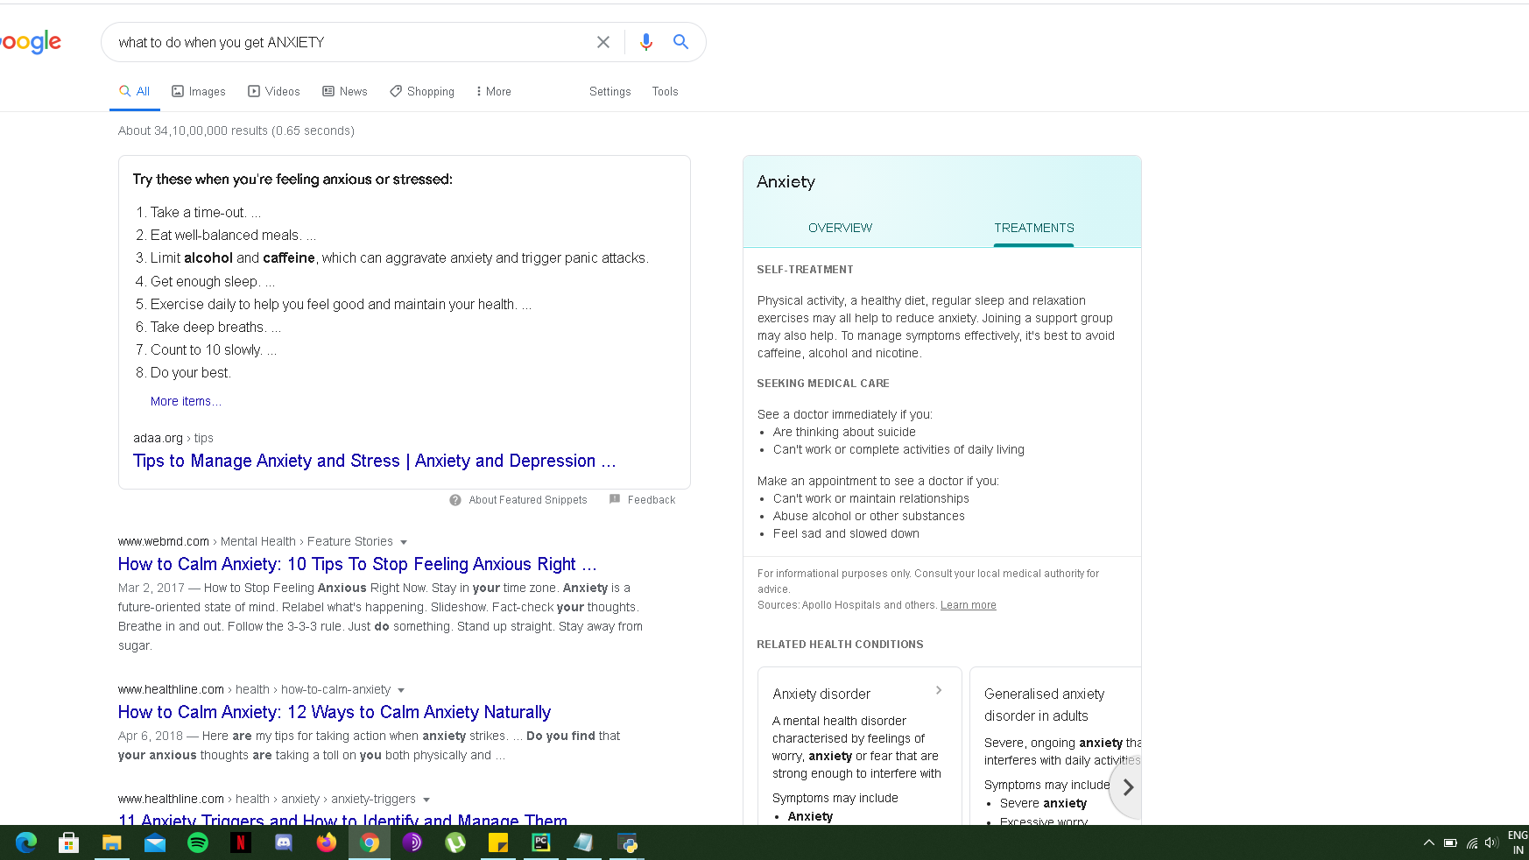
THE FIFTEENTH WINDOW
NOW IF YOU CHOOSE THE ANXIETY OPTION THEN THIS WILL LEAD YOU TO THIS GOOGLE SEARCH WINDOW.

Slide 18
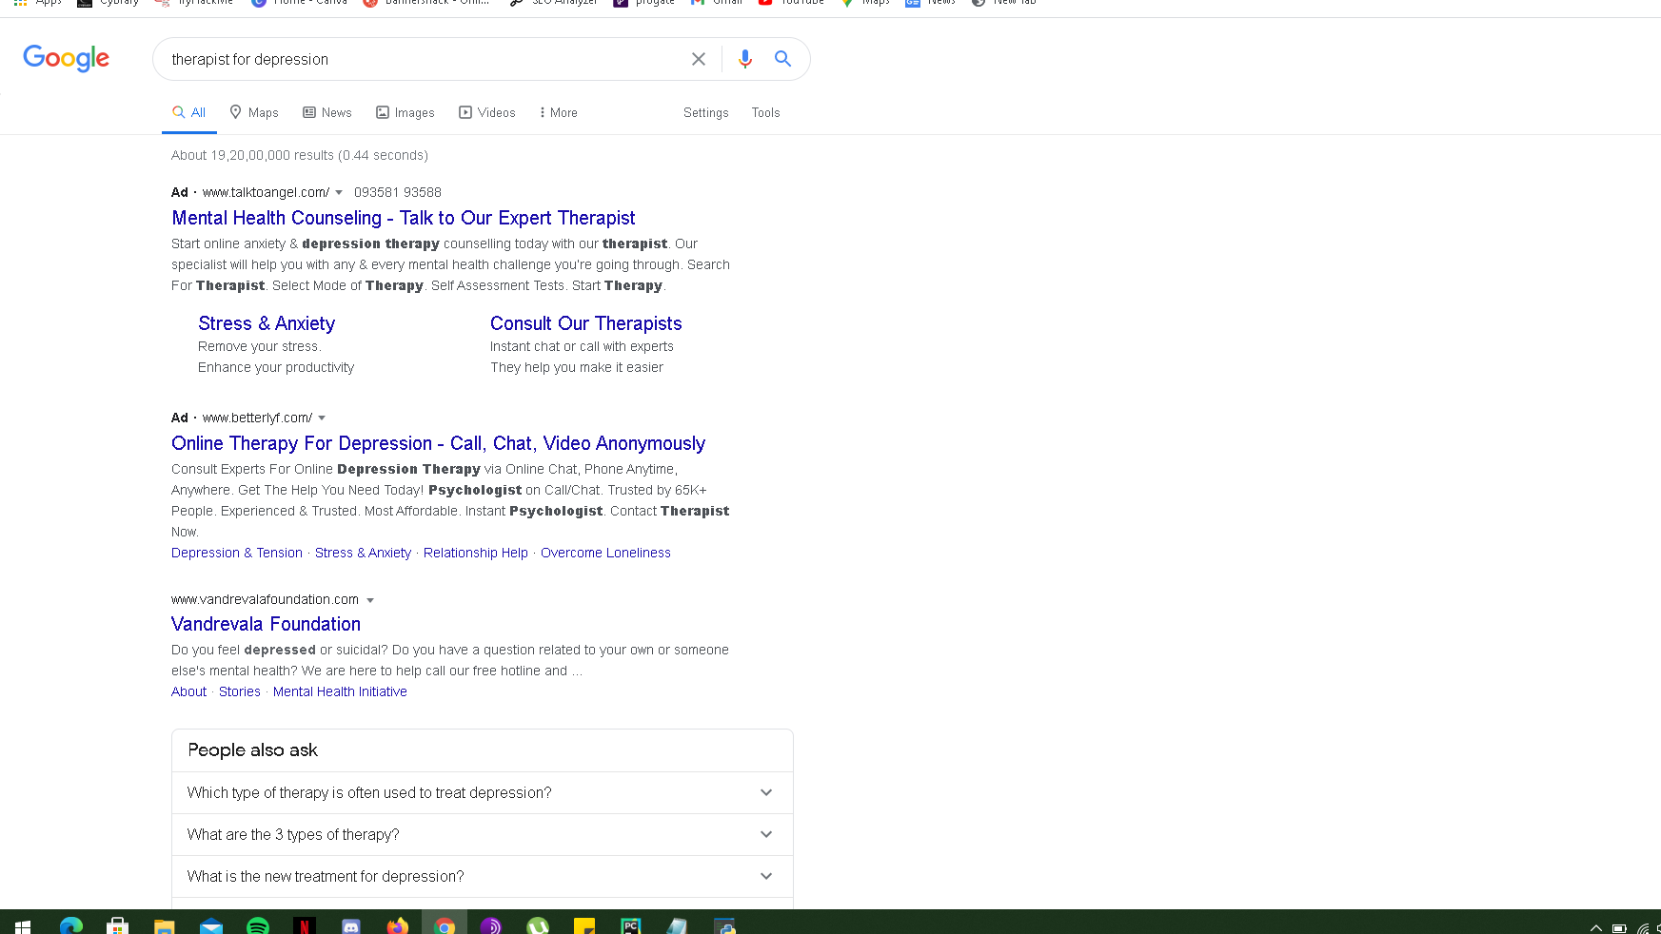
THE SIXTEENTH WINDOW
NOW IF YOU CHOOSE THE DEPRESSION OPTION THEN THIS WILL LEAD YOU TO THIS GOOGLE SEARCH WINDOW.

Slide 19
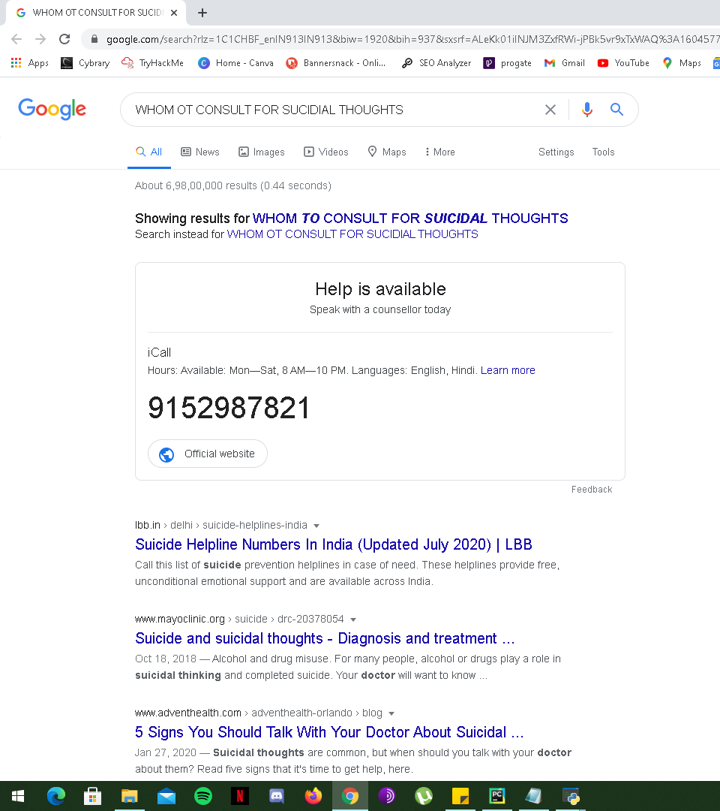
THE SEVENTEENTH WINDOW
NOW IF YOU CHOOSE THE SUCIDIAL THOUGHTS OPTION THEN THIS WILL LEAD YOU TO THIS GOOGLE SEARCH WINDOW.

Slide 20
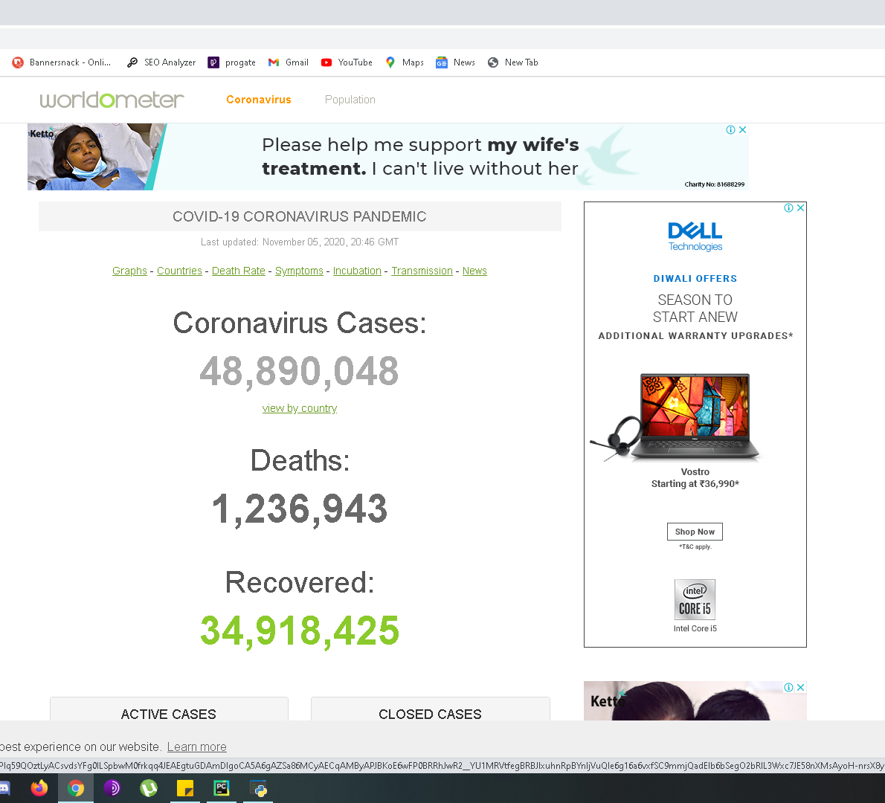
The eighteenth window
NOW IF YOU CHOOSE THE CORONA UPDATE BUTTON THEN THIS WILL LEAD YOU TO THIS LIVE UPDATE GOOGLE SEARCH WINDOW.

Slide 21
THANK YOU

